Slide 1
Homiletic Method
No Boring Homilies
Pope Francis
Priest Ordination, St. Peter’s Basilica
April 26, 2015
Notes:
Ensure “that your homilies are not boring, that your homilies arrive directly in people’s hearts because they flow from your heart, because what you tell them is what you have in your heart.”
If you speak from your heart, your homilies will not be boring.

Slide 2
Homiletic Method – Objective
Prepare and deliver a homily that is “a scriptural interpretation of human existence which enables a community to recognize God's active presence, to respond to that presence in faith through liturgical word and gesture, and beyond the liturgical assembly, through a life lived in conformity with the Gospel.”
Fulfilled in Your Hearing [81]
Notes:
2
Our homilies should enable people to recognize God’s action in their lives, to draw them to Christ, and to inspire them to go forth to live the Gospel message.
Our homilies should flow from our hearts formed by our own unique perspective of living the Gospel message.

Slide 3
Homiletic Method – Preaching as an Art
Preaching is an art based on a theory and a method
  Art: creativity, natural talent, skill, practice, patience (time)
  Theory: the objective of the homily, understanding its elements, knowing what makes it effective, becoming skilled in the use of applicable tools
  Method:
    Provides a framework, not step-by-step instructions
    Enables you to channel and direct your work more easily
    Enables you to work more efficiently within time constraints
    Orderly and regular; repeatable
    A regular pattern of activity that is more important than total time spent
    Works best when we set aside time daily for the process and honor it
Notes:
3
We do not all have the same natural talent. We must have the humility to recognize that there will be others who are better preachers.
Yet, with practice, patience, and using the method, we can all become good preachers.
Don’t take shortcuts or skip elements of the process.

Slide 4
Homiletic Method – Overview
Homiletic Method
  A model or framework
    Defines the major components of the creative process
    Designed for a one-week time frame (deacons often have more lead time)
  Configured by the individual preacher
    Experience (successes and failures)
    Examples (listening to other preachers)
    Patience (takes time to develop/refine your method and discover your style)
  Remote and continuing preparation
    Exegesis on the books, letters, and Gospels of the Scripture
    Lectio continua – reflect continuous (week-to-week) nature of the lectionary
Notes:
4
One Week:
If possible, don’t compress the process to less than a week.
I don’t recommend extending method across multiple weeks (can lose focus).
However, if too busy the week prior to preaching, you can prepare in earlier week (but review & practice prior to delivery)
Takes Time:
Preaching once a month at Sunday Mass extends the time it takes to discover and hone your style.
If possible, find opportunities to preach at daily Mass and communion services.
At 10 years a deacon, I have covered 110 of the possible 177 Sundays (62.15%).

Slide 5
Homiletic Method – Fundamental Steps
Reading, Listening, Praying
Study and Further Reflection
Letting Go
Drafting
Revising
Practicing
Preaching (covered next week)
Notes:
5

Slide 6
Reading, Listening, Praying
Begin early in the week (even on Sunday evening)
Read and reread the texts for the liturgy (for at least a day or two)
  Read familiar texts from a fresh perspective
  Read them aloud
  Read them in several versions (not just the NABR)
  Read all four texts (first reading, second reading, Psalm, Gospel)
    Look for thematic unity, but do not force it – it might not exist
    Even when not connected, texts may offer insights for central unifying idea
    However, it is not necessary to include all readings in your homily
  Read the texts in context from the Bible (what precedes and follows)
  Jot down ideas and insights (don’t worry about filtering them)
Notes:
6
Reading just from the lectionary does not provide context and reading more than one translation can clarify meaning.

Slide 7
Reading, Listening, Praying (continued)
Read prayerfully with an open heart and mind
  Approach the texts humbly, dwell with them, let them speak to you
  Read prayerfully
  Listen actively
  May employ Lectio Divina (Lectio, Meditatio, Oratio, Contemplatio)
Consider the Senses of Scripture – Exegesis (CCC 115-117)
    Literal
    Spiritual
      Allegorical (our faith)
      Moral (how we are to act)
      Anagogical (our destiny)
EISEGESIS
Notes:
7
Lectio Divina (divine reading): during meditation, view text from various perspectives - it may help to imagine yourself in the scene.
Avoid eisegesis – reading into the Scripture to fit your ideas or your agenda.
Senses of Scripture
Literal sense – the meaning conveyed by the words of Scripture and discovered by exegesis, following the rules of sound interpretation.
Spiritual sense – the realities and events about which the Scripture speaks can be signs.
The allegorical sense. We can acquire a more profound understanding of events by recognizing their significance in Christ; thus, the crossing of the Red Sea is a sign or type of Christ’s victory and also of Christian Baptism.
The moral sense. The events reported in Scripture ought to lead us to act justly. As St. Paul says, they were written “for our instruction.”
The anagogical sense (Greek: anagoge, “leading”). We can view realities and events in terms of their eternal significance, leading us toward our true homeland: thus, the Church on earth is a sign of the heavenly Jerusalem.
The Letter speaks of deeds; Allegory to faith;
The Moral how to act; Anagogy our destiny.

Slide 8
Study and Further Reflection
Avoid the temptation to start the process by consulting commentaries, and other expert resources!
  Inhibits the texts from speaking to us, and from our preparing a homily expressive of our own faith
  Blinds us to the concerns of the congregation we serve
  Leads to homilies that are academic rather than existential
  Leads to homilies about Scripture, rather than God’s Word speaking to people
Do consult the commentaries and other resources after personal reflection
  Validate the accuracy of our own interpretation
  Gain new insights and ideas, or to clarify our own ideas
Resources
Notes:
8
Resources:
Study Bibles (various versions/translations),
Didache Bible (NABR, RSV),
Homiletic Directory,
Commentaries (e.g., The New Jerome Biblical Commentary, Catena Aurea),
Lector Workbook, Living Liturgy,
Logos/Verbum, other online resources
Collect for the Mass
Scripture Summary from the Ordo

Slide 9
Letting Go
The initial steps often leave us with many thoughts, feelings, information, and ideas, but without a sense of order or connection
  Which themes to focus on
  What is the central unifying idea (core message)
  We may still not understand one or more passages
  We may sense a tension between the Word of God and the human situation
Step back and allow the subconscious mind to process and sort the information
Free our minds and open our hearts for the Holy Spirit to work within us and lead us to a deeper and richer understanding and faith (attend to other tasks, recreate, meditate, listen to music)
Notes:
9
I am grateful when the Spirit comes to me, and I achieve that “ah ha” moment.
Unfortunately, He chooses to visit most often about 20 minutes after I go to bed. I realize that He is probably always trying to reach me, but it is when I go to bed that my mind quiets down enough for me to feel his presence and listen to Him.

Slide 10
Drafting
Begin drafting your homily at least two days before preaching
Focus on getting ideas down rather than on style, sentence structure or cohesiveness – this gives you something to work with
Writing will stimulate fresh ideas, clarify your understanding of difficult passages, remind you of relevant events or stories, and help formulate a central unifying idea for your homily
Simply write as if sketching or outlining your homily. Don’t waste time crafting well-structured sentences, searching for the perfect word, or even getting the proper sequence of ideas (this is done during revision)
The very act of writing calls to the surface the ideas and words that will become the “stuff” of which your homilies will be made.
Notes:
10
The amount of time may vary for you. Right after I was ordained, I tried to start writing too soon, leading to much rewriting. I am now comfortable waiting to write. If I have an entire Saturday available, I can write, revise and practice in that one day.
Leave yourself enough time for adequate revision.
Bullet 3: In formulating your homily avoid overly intellectual or theological or strong apologetic themes

Slide 11
Drafting – Literary Elements
Personal stories (caution with family members)
Human interest stories
Quotations
Current events
Requested Content (Pope/bishop/pastor)
Humor (don’t overuse, must be relevant, the homily is not entertainment)
Prayers (either as quote or at end of homily)
Interesting facts (use sparingly)
Catechesis
Notes:
11
Examples of requested content: March 2019 Safe Haven Sunday, parish commitment weekend/stewardship
Example prayer: Feast of Holy Family - ended with prayer by Pope Francis at December 2013 Angelus Message prior to 2014 Synod on the Family.
Example fact: Specifying the approximate amount of water turned into wine at Cana – 945 bottles
Example fact: In 2019, we heard 6th, 7th and 8th Sundays in ordinary time – previously heard in 2010, 2007, 2001, respectively.

Slide 12
Drafting – Use of Artificial Intelligence
Practices to Avoid
  Do not use AI to create or draft your reflections or homilies
  Do not use AI to replace personal prayer, reflection, or Lectio Divina
  Do not present AI-generated stories as your own
Use AI tools to …
  Better understand the context and historical facts regarding the Scripture
  Gain new insights and ideas, or to clarify your own ideas (always verify sources)
  Check spelling and grammar and to refine syntax and structural flow of your original drafts
CAUTION: Bypassing the personal reflection and drafting in forming
a homily weakens your pastoral and preaching ministry.
Notes:
12
Be careful when using AI. Verify the sources. Verify consistency with Church teaching. Try Magisterium AI.

Slide 13
Revising
Revising is an important and repetitive process
Cut – Extraneous material that does not support the central idea
– Ensure homily is not repetitive, wandering, or too long (note word count)
Verify there is a central unifying idea (common thread, core message)
Maintain a balance between challenging and chastising the people
Arrange the material to gain and hold people’s attention and invite them to a response of faith in God’s Word.
  Opening – grab attention (literary element); introduce central unifying idea
  Body – reinforce the message; smooth flow from opening to closing
  Closing – invite a response; bridge the Word to the Eucharist
Notes:
13
Repetition of the theme/core message is desirable
Why write and spend time revising a homily?
Stimulate and organize ideas, keep homily on point, keep it to length
Can be used during preaching
Have a record in case someone reports something you said to the Bishop

Slide 14
Revising (continued)
General editing
  Revise complex sentences
  Replace jargon, technical, and theological terms
  Remove unnecessary and extraneous words
  Substitute vague generalities with specific examples
  Remove cliches, use inclusive language, be sensitive to political views
Ensure your homily is an integral part of the liturgy
  Conclusion should lead the assembly into the liturgy that follows
  God becomes more present in the people’s lives and draws them into worship
  Flows out of the Scriptures of the Liturgy of the Word and into the prayers and actions of the Liturgy of the Eucharist
Notes:
14
Inclusive Language: Dear Brothers and Sisters rather than Dear Brethren. Don’t assume all women are stay-at-home moms. Yet, avoid cumbersome constructs like he/she. Also, we don’t acknowledge gender fluidity or non-binary gender.
During general editing, I often use the “Read Aloud” feature of Word to help clarify the text and find missing words that my mind fills in when I read the text.

Slide 15
Practicing
After revising the homily, practice, practice, practice
Practice it aloud, several times:
  Ask yourself, “Is this really me speaking?”
  Does it sound natural
  Does it contain words or phrases not suited to oral communication
Preach your homily to friend, coworker, or family member
Record your presentation and listen to it
Time your delivery (6 – 8 minutes)
Make revisions as necessary
Notes:
15
I find it useful, if I have time, to take breaks between practicing.
Do not plan to talk fast to fit a 2000-word homily into 8 minutes.

Slide 16
Homily Preparation Group
Benefits
  Helps the homilists address the real concerns of the congregation
  Helps the homilists prepare more concrete homilies that gain and hold people’s attention and invite them to a response of faith in God’s Word
Members
  Priests
  Deacons
  Four or five representatives from the congregation
I don’t know how common this is in our diocese
  I have heard of the deacons at a parish gather to discuss the readings
Notes:
16

Slide 17
Non-Negotiables
Looking into the faces of the people who sit before us, we see
those who are holier, more intelligent, and more creative. And
yet they wait for us to speak, to preach, to proclaim and witness
to the presence of God among us. _{[FYH 113]}
Effective preaching requires time and serious effort
There is no one way to prepare, but the following are essential:
  Time – more challenging for deacons, but shortcuts lead to ineffective preaching
  Prayer – preaching flows from faith; prayer nourishes faith
  Study – continuing study prevents stagnation and insipid preaching
  Organization – the homiletic method ensures there is a point to what we preach
  Concreteness – avoid vague generalities and technical, theological language
  Evaluation – seek feedback from others to ensure our homilies remain fresh
Notes:
17
Take this responsibility seriously – through your words, you can draw people toward Christ or chase them away from the Church.

Slide 18
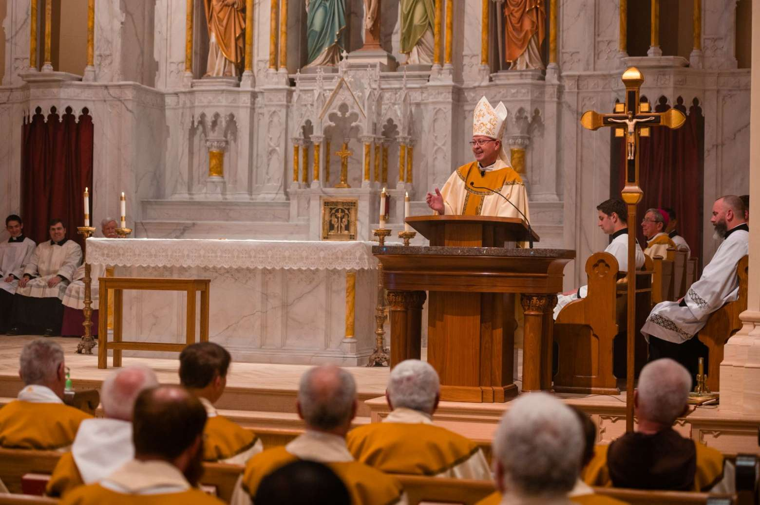
Notes:
Bishop James Golka preaching at the 2022 Chrism Mass.

